Slide 1
18-349: Introduction to Embedded Real-Time Systems
Lecture 22: Embedded Security
Anthony Rowe
Electrical and Computer Engineering
Carnegie Mellon University

Slide 2
Administrivia
Lab 4 due next Wednesday (Dec. 7th)
Redemption Lab due (Dec. 12th)
Final (Friday Dec. 16th 8:30-11:30am)

Slide 3
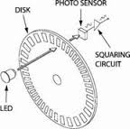

Lab 4 Encoders
Spin Right
Chan A: 0 1 1 0 0 1
Chan B: 0 0 1 1 0 0
Spin Left
Chan A: 0 0 1 1 0 0
Chan B: 0 1 1 0 0 1
Two pins, rising and falling edges
-> 1 interrupt handlers
{Ch a,Ch b}
{Ch a,Ch b}
0,0
cnt++
cnt++
0,0
cnt--
cnt--
0,1
1,0
0,1
1,0
1,1
cnt++
cnt++
cnt--
cnt--
1,1

Slide 4
Lab 4 PWM Generation
Periodic Interrupt from HR Timer
Reset cnt
High tick cnt
Low tick cnt
Variable Interrupt from HR Timer
Duty-Cycle = High Cnt / Low Cnt
Set Wakeup for High time
Set Wakeup for Low time
Repeat…
Duty-Cycle = High Time / Low Time

Slide 5
Four Cornerstones of Security
Software Security
Network Security
OS Security
Cryptography
All Apply in Terms of Embedded

Slide 6
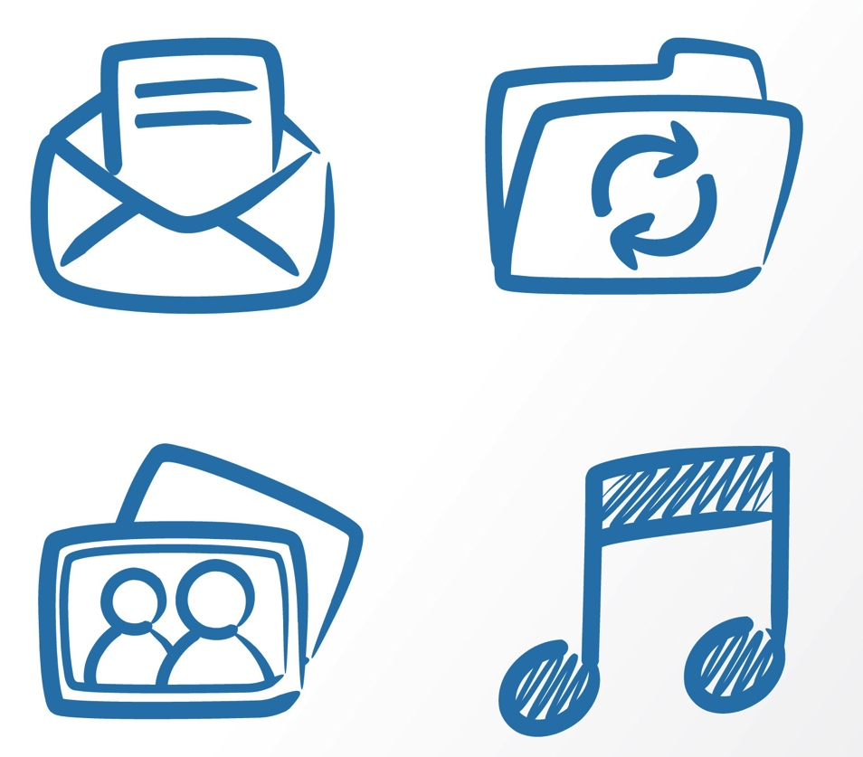
Computers + Adversary = Security.
Topic:
Compilers
OS
Networking
Codes
User Interface
Theory
Programming languages
Adversary
+

Slide 7
Outline
Jeep Attack
Airplane vulnerabilities?
Internet of Things
Notes:
https://www.blackhat.com/docs/asia-15/materials/asia-15-Evenchick-Hopping-On-The-Can-Bus.pdf
https://www.wired.com/2015/07/hackers-remotely-kill-jeep-highway/

Slide 8
Hackers Attack Jeep
Video:
https://www.wired.com/video/hackers-wireless-jeep-attack-stranded-me-on-a-highway

Slide 9
Why Did This Work?
Jeep was connected to cellular internet
CAN bus is insecure!
Pivot from cellular internet to internals of vehicle

Slide 10
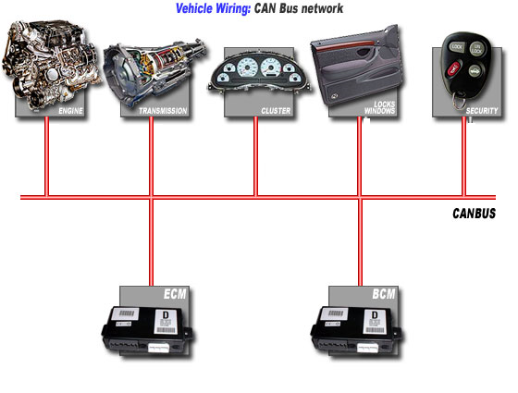
Recall the CANbus?
Shared serial bus, send at 1Mbps, maximum bus length is 50m
All stations hear transmissions within a fraction of a bit time
Connections wired together as a logical AND function
Packets start with an ID, then control and data
Widely used in automotive
Finding its way to other areas
ID
Control
Data
Start of packet

Slide 11
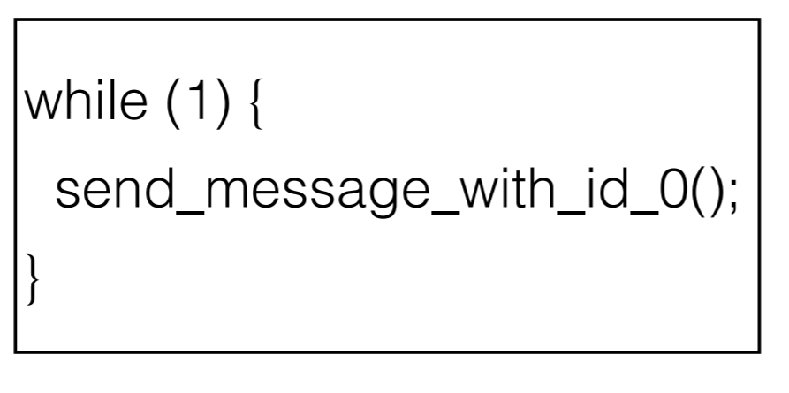
Recall the CANbus?
Any device can impersonate any other device!
Below is a simple denial of service (DoS) attack
ID
Control
Data
Start of packet
Notes:
https://www.blackhat.com/docs/asia-15/materials/asia-15-Evenchick-Hopping-On-The-Can-Bus.pdf

Slide 12

Recall the CANbus?
One possible solution is to add a firewall
Prevent devices from using an ID that is not their own (and perhaps even masking messages not intended for them)
ID
Control
Data
Start of packet
Notes:
http://www.crossborder-technologies.com/node/85

Slide 13
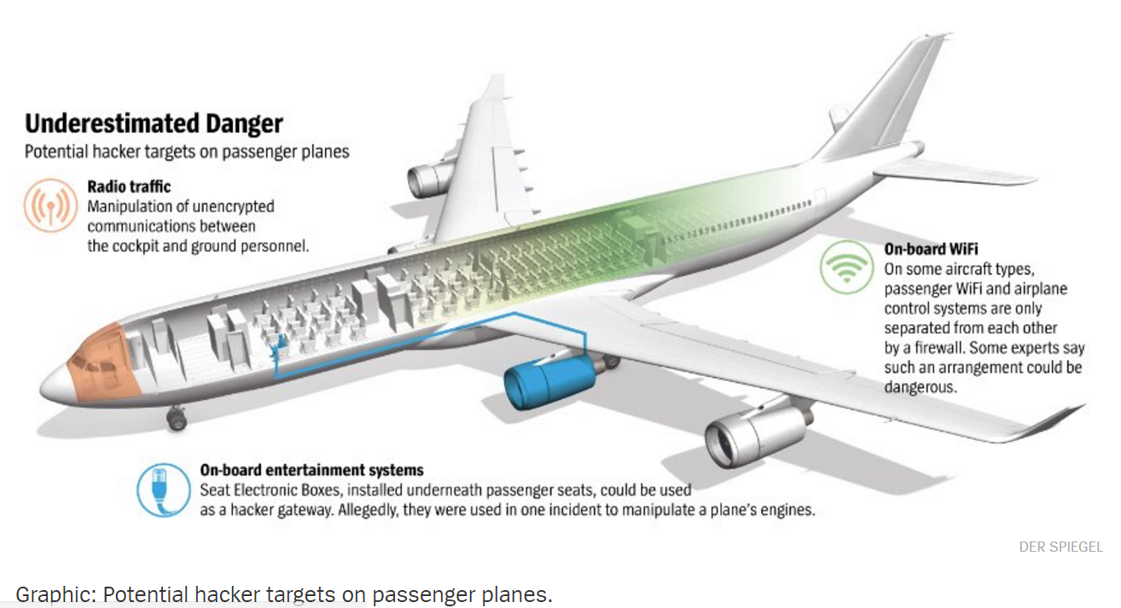
What about planes?

Slide 14
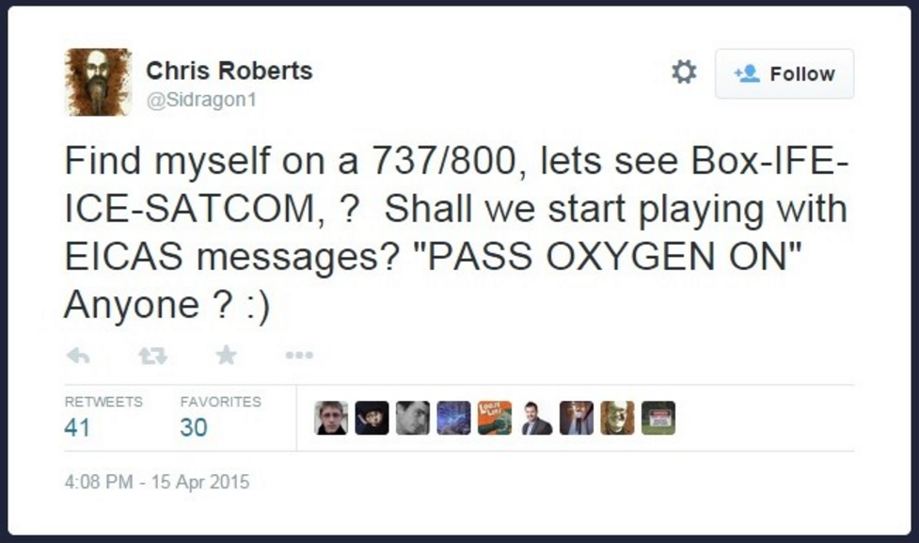
What about planes?
Security researcher interviewed by FBI, barred from United flight
Notes:
http://money.cnn.com/2015/04/17/technology/security/fbi-plane-hack/

Slide 15
What about planes?
During two interviews with F.B.I. agents in February and March of this year, Roberts said he hacked the inflight entertainment systems of Boeing and Airbus aircraft, during flights, about 15 to 20 times between 2011 and 2014. In one instance, Roberts told the federal agents he hacked into an airplane's thrust management computer and momentarily took control of an engine, according to an affidavit attached to the application for a search warrant.
"He stated that he successfully commanded the system he had accessed to issue the 'CLB' or climb command. He stated that he thereby caused one of the airplane engines to climb resulting in a lateral or sideways movement of the plane during one of these flights," said the affidavit, signed by F.B.I. agent Mike Hurley.
Notes:
http://money.cnn.com/2015/04/17/technology/security/fbi-plane-hack/

Slide 16
What about planes?
Two key things stand out:
There’s an Ethernet port under your seat?!?
There’s a connection between the entertainment system and the plane’s avionics?!?
Notes:
http://money.cnn.com/2015/04/17/technology/security/fbi-plane-hack/

Slide 17
Internet of Things
What other things are now on the internet?
DVRs
Home security systems
Refrigerators?
Notes:
http://money.cnn.com/2015/04/17/technology/security/fbi-plane-hack/

Slide 18
Internet of Things
DEFCON 2016
47 vulnerabilities in 23 IOT devices
Smart door locks
Padlocks
Thermostats
Refrigerators
Wheelchairs
Solar panel arrays
Notes:
http://www.csoonline.com/article/3119765/security/hackers-found-47-new-vulnerabilities-in-23-iot-devices-at-def-con.html

Slide 19
Oct 2016 DDoS on Internet
500,000 DVRs involved in Mirai botnet
https://www.dynstatus.com/incidents/nlr4yrr162t8
“Investigating
Starting at 11:10 UTC on October 21st-Friday 2016 we began monitoring and mitigating a DDoS attack against our Dyn Managed DNS infrastructure. Some customers may experience increased DNS query latency and delayed zone propagation during this time. Updates will be posted as information becomes available. ”
By attacking DNS, prevented users from getting to websites without attacking the websites themselves.
Main culprit – default username/passwords
Notes:
http://www.popularmechanics.com/technology/infrastructure/a23504/mirai-botnet-internet-of-things-ddos-attack/
https://github.com/jgamblin/Mirai-Source-Code
http://www.popularmechanics.com/technology/infrastructure/a23482/dyn-ddos-attacks/
https://www.dynstatus.com/incidents/nlr4yrr162t8

Slide 20
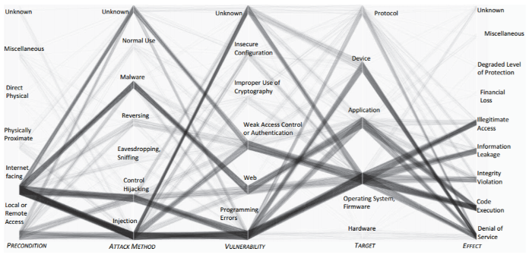
A taxonomy of embedded attacks
Notes:
http://www.cse.psu.edu/~pdm12/cse597g-f15/readings/cse597g-embedded_systems.pdf

Slide 21
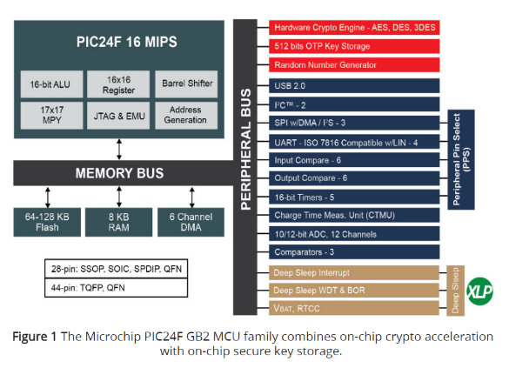
Embedded Crypto
Many embedded
chips are now
providing hardware
crypto accelerators
to reduce load on
MCU
Notes:
http://www.embedded.com/electronics-blogs/systems-check/4438910/Embedded-security-rises-and-falls-with-crypto-key-management

Slide 22
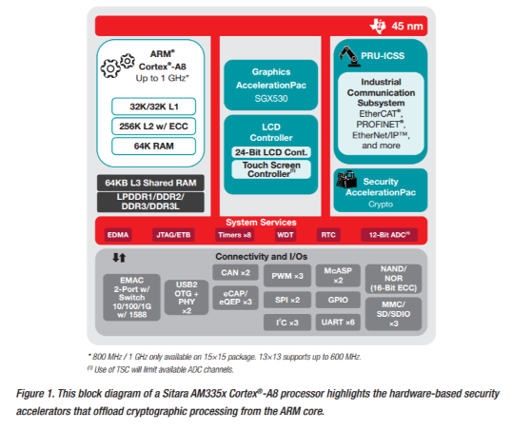
Embedded Crypto
Notes:
http://www.ti.com/lit/wp/spry198a/spry198a.pdf

Slide 23
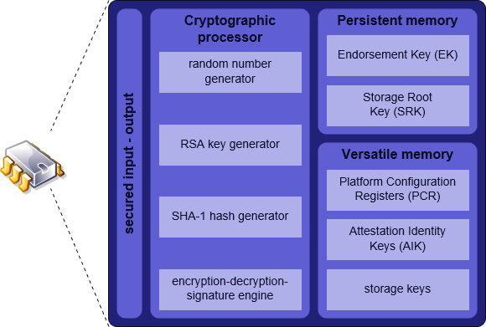
TPM
Built-in chip Able to:
Perform RSA 2048
Perform SHA-1 hashing
Create keys tied to chip
Support full-disk encryption (can’t remove hd and put in another machine)
Store data (e.g. fingerprint)
By This figure was made by Eusebius (Guillaume Piolle). Own work, LGPL,
https://commons.wikimedia.org/w/index.php?curid=4809738
Notes:
http://www.pcworld.com/article/157966/laptop_security.html
The TPM is a chip soldered on to the laptop's motherboard, providing hardware-based device authentication, tamper detection, and encryption key storage. The TPM generates encryption keys, keeping half of the key information to itself, making it impossible to recover data from an encrypted hard drive apart from the computer in which it was originally installed. Even if an attacker gets the user's part of the encryption key or disk password, the TPM-protected drive's contents can't be read when connected to another computer. Further, the TPM generates a unique digital signature from the motherboard in which it's embedded, foiling attempts to move the TPM chip itself to another machine.

Slide 24
What is TPM?
The TPM is a microcontroller that stores keys, passwords and digital certificates.
It typically is affixed to the motherboard of a PC, but can be used in any computing device that requires these functions.
The nature of this silicon ensures that the information stored there is made more secure from external software attack and physical theft.
Notes:
Copied from Trusted Computing Platform Alliance
–
Introduction and Technical Overview
– Joe Pato
HP Labs
MIT 6.805/6.857
17 October 2002

Slide 25


The Trusted Computing Platform Alliance - TCPA -
An Industry work group focused on defining and advancing the concept of Trusted Computing
Founded in 1999 by Compaq, HP, IBM, Intel, and Microsoft.
180+ members from the hardware, software, communications, and security technology industries
Notes:
Copied from Trusted Computing Platform Alliance
–
Introduction and Technical Overview
– Joe Pato
HP Labs
MIT 6.805/6.857
17 October 2002

Slide 26

The TCPA charter
Provide a ubiquitous and widely adopted means to address trustworthiness of computing platforms
Publish an open specification for public review – Not security by obscurity
Define a technology specification that can be applied to any type of computing platform (not just PCs!)
Notes:
Copied from Trusted Computing Platform Alliance
–
Introduction and Technical Overview
– Joe Pato
HP Labs
MIT 6.805/6.857
17 October 2002

Slide 27


The Core Root of Trust for Measurement - CRTM -
The CRTM is the first piece of code that executes on a platform at boot time. (I.e. Bios or Bios BootBlock in an IA-32 platform)
It must be trusted to properly report to the TPM what software executes after it.
Only authorized entities must be able to reflash the CRTM… (those that vouch for its behavior)

Slide 28

CRTM and TPM during the boot process
The Authenticated boot process
OpRom1
OpRom 2
OpRomN
Hash code
Hash code
CRTM - Bios BootBlock
Hash code
BIOS
Hash code
OSLoader
Hash code
OS
Hand-Off
Hand-Off
Hand-Off
Report Hashed code
Report Hashed code
TPM
Report Hashed code

Slide 29
TPM as an Endpoint of Communication (1/2)
Classic message exchange based on asymmetric cryptography suggests that messages intended for one and only one individual can be encrypted using a public key.
Furthermore, the message can be protected from tampering by signing with the private key.
Keys are communication endpoints and improperly managed keys can result in loss of security.
Additionally, improperly configured endpoints may also result in loss of security.
The TPM aids in improving security by providing both key management and configuration management features.
Notes:
http://www.cmlab.csie.ntu.edu.tw/~ipr/ipr2006/data/lecture/Lecture13%20-%20Trusted%20Platform%20Module%20(TPM).pdf

Slide 30
TPM as an Endpoint of Communication (2/2)
Four classes of protected message exchange:
Binding
The sender uses the public key of the intended recipient to encrypt the message.
When the private key is managed by the TPM as a non-migratable key only the TPM that created the key may use it.
Signing
Signing associates the integrity of a message with the key used to generate the signature.
Sealing
Sealing takes binding one step further. Sealed messages are bound to a set of platform metrics specified by the message sender.
Sealed-Signing
Signing operations can also be linked to PCR registers as a way of increasing the assurance that the platform that signed the message meets a specific configuration requirement.
Notes:
http://www.cmlab.csie.ntu.edu.tw/~ipr/ipr2006/data/lecture/Lecture13%20-%20Trusted%20Platform%20Module%20(TPM).pdf

Slide 31
Key Attributes
All keys managed by the TPM have an attribute designation of migratable or non-migratable.
The key attribute determines whether a key may be transferred from one TPM to another.
Attribute value is established at the time the key is created and cannot be changed.
Notes:
http://www.cmlab.csie.ntu.edu.tw/~ipr/ipr2006/data/lecture/Lecture13%20-%20Trusted%20Platform%20Module%20(TPM).pdf

Slide 32
Key Types (1/2)
Signing keys
Asymmetric general purpose keys used to sign application data and messages.
Signing keys can be migratable or non-migratable. Migratable keys may be exported / imported between TPM devices. The TPM can sign application data and enforce migration restrictions.
Storage keys
Asymmetric general purpose keys used to encrypt data or other keys.
Storage keys are used for wrapping keys and data managed externally.
Identity Keys (a.k.a. AIK keys)
Non-migratable signing keys that are exclusively used to sign data originated by the TPM (such as TPM capabilities and PCR register values).
Notes:
http://www.cmlab.csie.ntu.edu.tw/~ipr/ipr2006/data/lecture/Lecture13%20-%20Trusted%20Platform%20Module%20(TPM).pdf

Slide 33
Key Types (2/2)
Endorsement Key (EK)
A non-migratable decryption key for the platform.
It is used to decrypt owner authorization data at the time a platform owner is established and to decrypt messages associated with AIK creation.
It is never used for encryption or signing.
Bind keys
May be used to encrypt small amounts of data (such as a symmetric key) on one platform and decrypt it on another.
Legacy Keys
Keys created outside the TPM. They are imported to the TPM after which may be used for signing and encryption operations.
They are by definition migratable.
Authentication Keys
Symmetric keys used to protect transport sessions involving the TPM.
Notes:
http://www.cmlab.csie.ntu.edu.tw/~ipr/ipr2006/data/lecture/Lecture13%20-%20Trusted%20Platform%20Module%20(TPM).pdf

Slide 34
Protected Storage
External Storage To allow for virtually unlimited keys and storage areas the RTS packages keys destined for external storage into encrypted key BLOBs.
Key Cache Management The TPM exposes interfaces that allow external programs the ability to manage the limited storage resources of the TPM.
Notes:
http://www.cmlab.csie.ntu.edu.tw/~ipr/ipr2006/data/lecture/Lecture13%20-%20Trusted%20Platform%20Module%20(TPM).pdf

Slide 35
Privacy Considerations
The TCG privacy model generally follows the privacy guiding principles established by the W3C P3P working group
Notice and Communication
Service providers should provide timely and effective notices of their information practices, and user agents should provide effective tools for users to access these notices and make decisions based on them.
Choice & Control
Users should be given the ability to make meaningful choices about the collection, use, and disclosure of personal information.
Fairness & Integrity
Users should retain control over their personal information and decide the conditions under which they will share it. Service providers should treat users and their personal information with fairness and integrity. This is essential for protecting privacy and promoting trust.
Confidentiality
Users' personal information should always be protected with reasonable security safeguards in keeping with the sensitivity of the information.
Notes:
http://www.cmlab.csie.ntu.edu.tw/~ipr/ipr2006/data/lecture/Lecture13%20-%20Trusted%20Platform%20Module%20(TPM).pdf

Slide 36
Criticisms
Remote attestation creates an unforgeable summary of the software on a computer
Still a potential threat to privacy.
Binding and sealing
A herald to Digital Rights Management systems of unprecedented restrictiveness.
Notes:
http://www.cmlab.csie.ntu.edu.tw/~ipr/ipr2006/data/lecture/Lecture13%20-%20Trusted%20Platform%20Module%20(TPM).pdf
"The chip's inclusion with the Apple hardware does not come as a complete surprise. It has been previously suggested that Apple could use the TPM to prevent computer users installing the OS X operating system on a non-Mac computer.“ -- http://lowendmac.com/intel/05/0811.html

Slide 37
BitLocker™ Drive Encryption
BitLocker™ Drive Encryption gives you improved data protection on your Windows
Notebooks – Often stolen, easily lost in transit
Desktops – Often stolen, difficult to safely decommission
Servers – High value targets, often kept in insecure locations
All three can contain very sensitive IP and customer data
Designed to provide a transparent user experience that requires little to no interaction on a protected system
Prevents thieves from using another OS or software hacking tool to break OS file and system protections
Prevents offline viewing of user data and OS files
Provides enhanced data protection and boot validation through use of a Trusted Platform Module (TPM)
Notes:
Shon Eizenhoefer, BitLocker™ Drive Encryption Hardware Enhanced Data Protection

Slide 38
BitLocker™ Drive Encryption Architecture Static Root of Trust Measurement of boot components
Notes:
Shon Eizenhoefer, BitLocker™ Drive Encryption Hardware Enhanced Data Protection

Slide 39


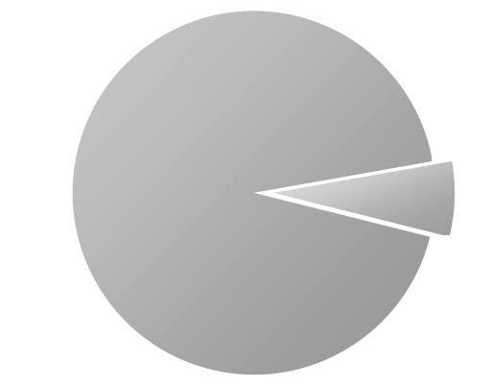
Disk Layout And Key Storage
OS Volume Contains
Encrypted OS
Encrypted Page File
Encrypted Temp Files
Encrypted Data
Encrypted Hibernation File
Where’s the Encryption Key?
SRK (Storage Root Key) contained in TPM
SRK encrypts FVEK (Full Volume Encryption Key) protected by TPM/PIN/USB Storage Device
FVEK stored (encrypted by SRK) on hard drive in the OS Volume
3
OS Volume
2
FVEK
1
SRK
System
System Volume Contains:
MBR, Boot manager, Boot Utilities
(Unencrypted, small)
Notes:
Shon Eizenhoefer, BitLocker™ Drive Encryption Hardware Enhanced Data Protection

Slide 40




Spectrum of Protection
Ease of Deployment / Maintenance
BitLocker™ offers a spectrum of protection, allowing an organization to customize according to its own needs
TPM Only
“What it is”
Protects Against:
Most SW attacks
Vulnerable To:
Hardware attacks
User Must:
N/A
No user impact
TPM + PIN
“What it is + what you know”
Protects Against:
Many HW attacks
Vulnerable To:
Hardware attacks
User Must:
Enter PIN to boot
TPM + USB
“What it is + what you have”
Protects Against:
HW attacks
Vulnerable To:
Stolen USB key
User Must:
Protect USB key
USB Only
“What you have”
Protects Against:
HW attacks
Vulnerable To:
Stolen USB key
No boot validation
User Must:
Protect USB key
Notes:
Shon Eizenhoefer, BitLocker™ Drive Encryption Hardware Enhanced Data Protection

Slide 41
Notes:
Intel builds on TPM with “Trusted Execution Technology”

Slide 42
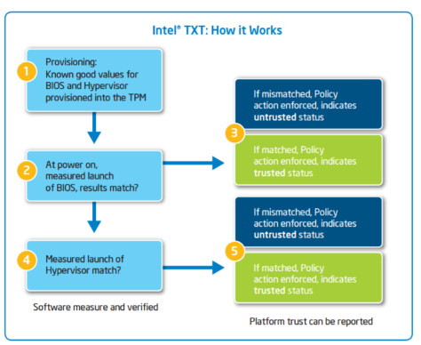

Slide 43
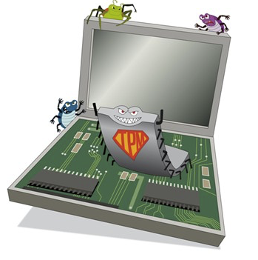
The Future of the TPM
Cellular services
Streaming Content (music / video)
Ink Cartridges
3D print cartridges
Bench equipment
Consumer electronic systems
Automobiles, etc…

Slide 44
Conclusions
Embedded Security is a hot topic
Problems aren’t going away (IoT)
Hardware Accelerated Encryption
Trusted Platform Modules
Intersection between hardware and OS Software
Next Class: Final Review!

